Slide 1
EE3030 Probability — Final Project Proposal (Group 5)
Idea1 Topic: find the relationship of restaurant choose among place choose, time choose, and gender during lunch break in nthu

Slide 2

Preface
Main choice of restaurant in NTHU:
1. 小吃部
2. 水木
3. 風雲樓
Problem:
Does the gender, places, and meal time will interfere with each other? Or they are just unrelated to each other ?

Slide 3
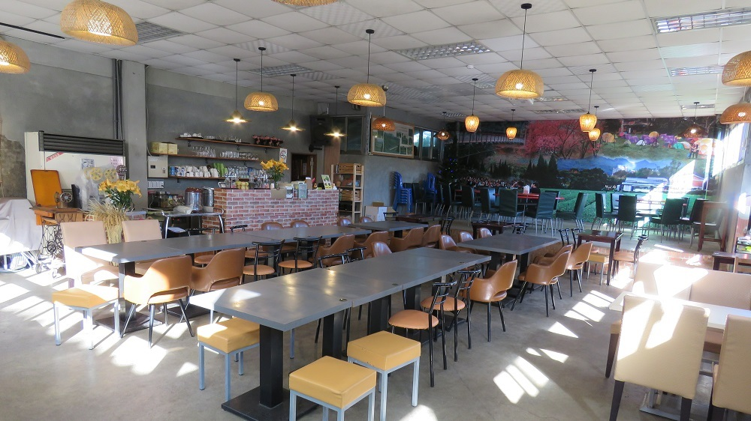


Goal of project
Find the relationship between gender, place choose, and meal time choose.

Slide 4
Method of collecting data
research
小吃部
水木
風雲2F
風雲3F
12:00~12:30
12:30~13:00
12:00~12:30
12:30~13:00
12:00~12:30
12:30~13:00
12:00~12:30
12:30~13:00
Mon~Fri
Mon~Fri
Mon~Fri
Mon~Fri
Mon~Fri
Mon~Fri
Mon~Fri
Mon~Fri
male
female
male
male
female
male
female
male
female
male
female
male
female
male
female
female

Slide 5
Principle of collecting the data
1. At the meal time, each place “only needs to choose an entrance to collect data” (even there are two entrances, we still choose one to count the number of people)
2. we only have to count the people “come in” the restaurant, the ones exit shouldn’t be counted.

Slide 6
3. The male and female people should be counted separately.
4. No matter the person is a student or not, he/she should be counted.

Slide 7
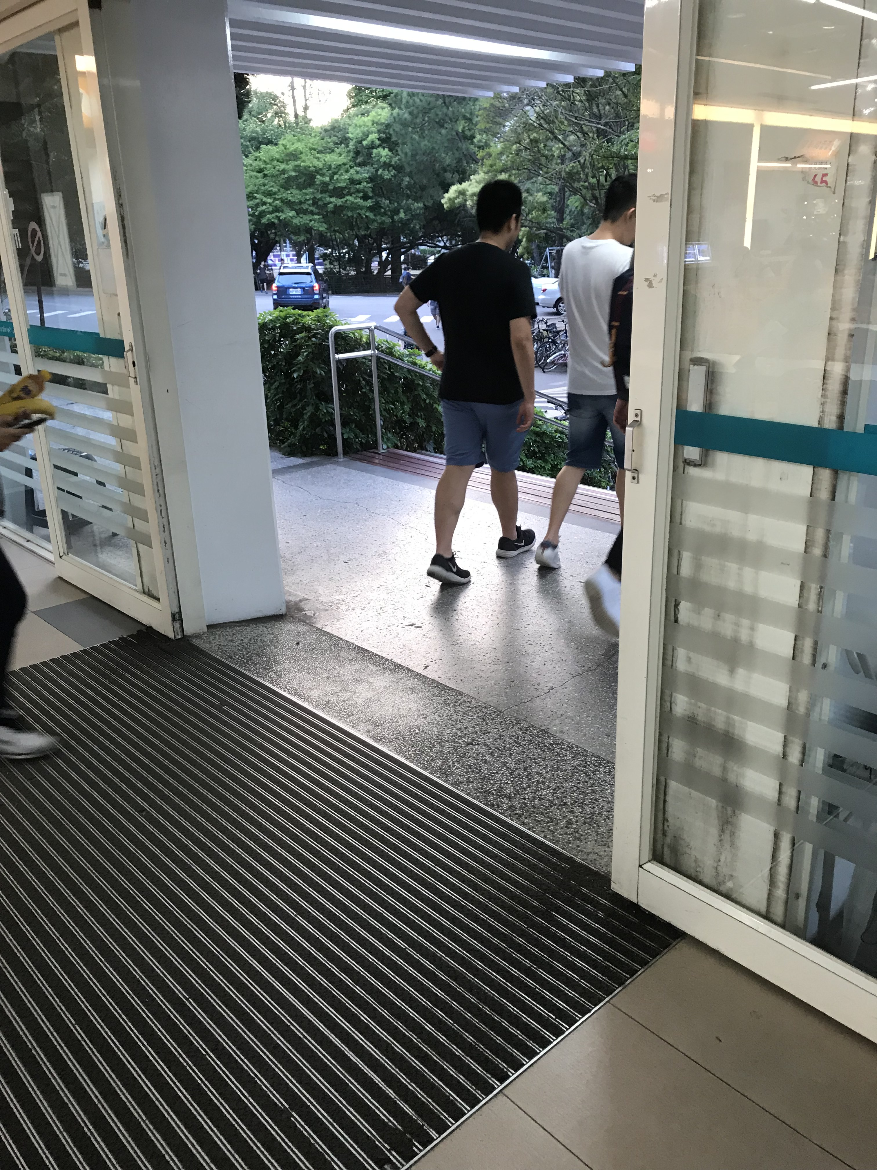
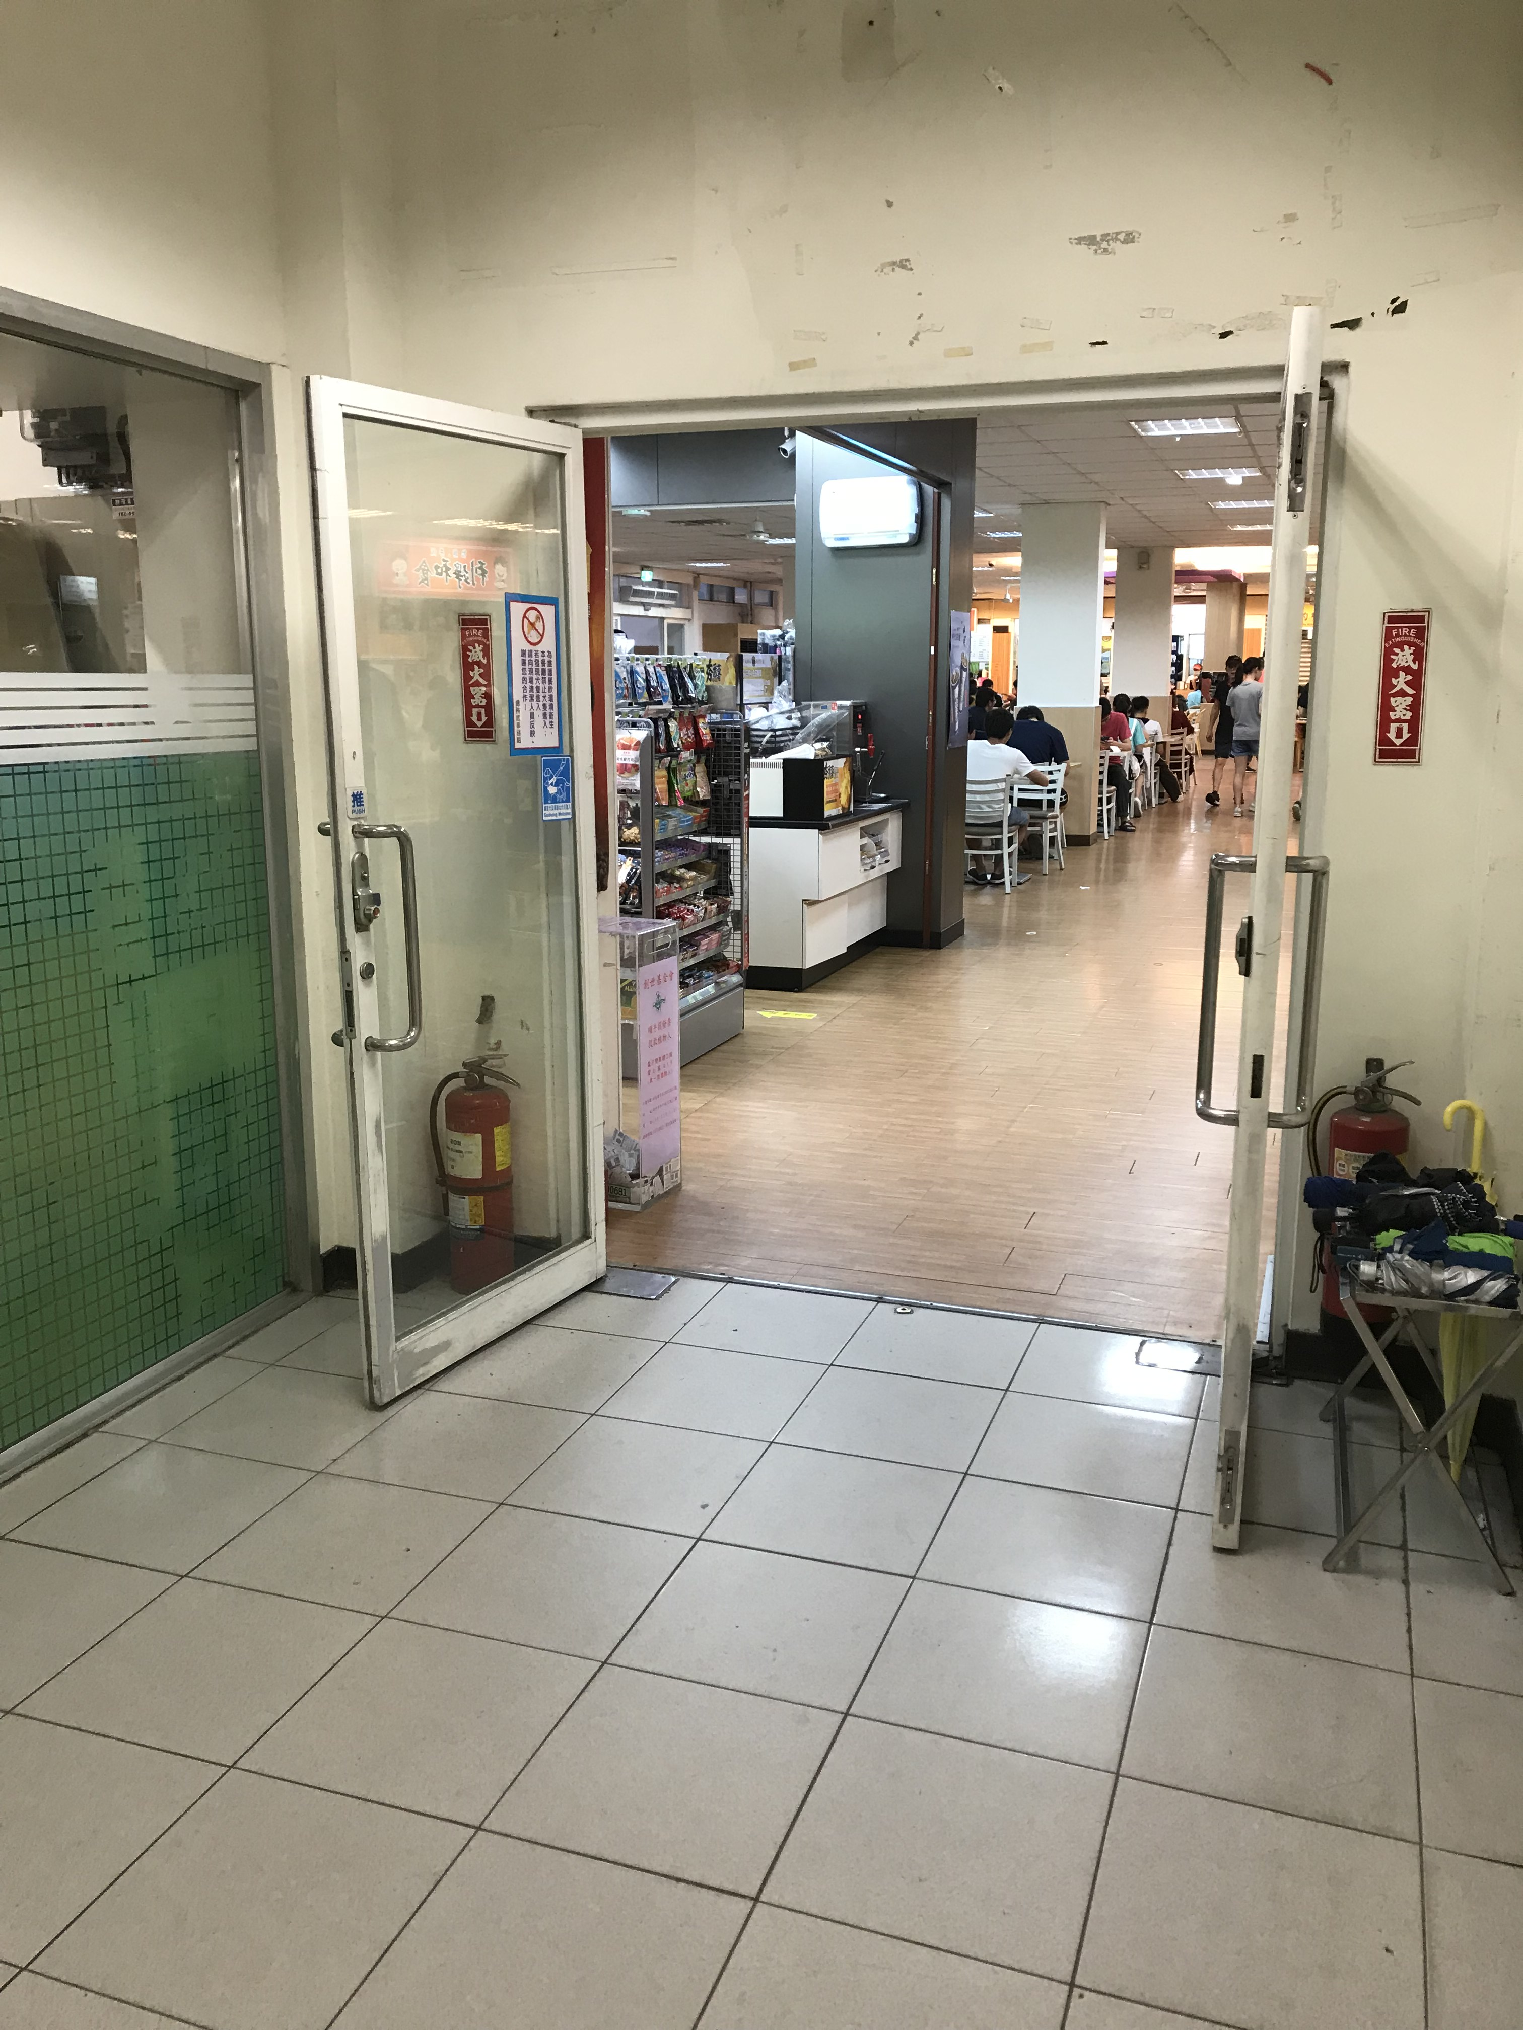
Place choose
小吃部
水木

Slide 8
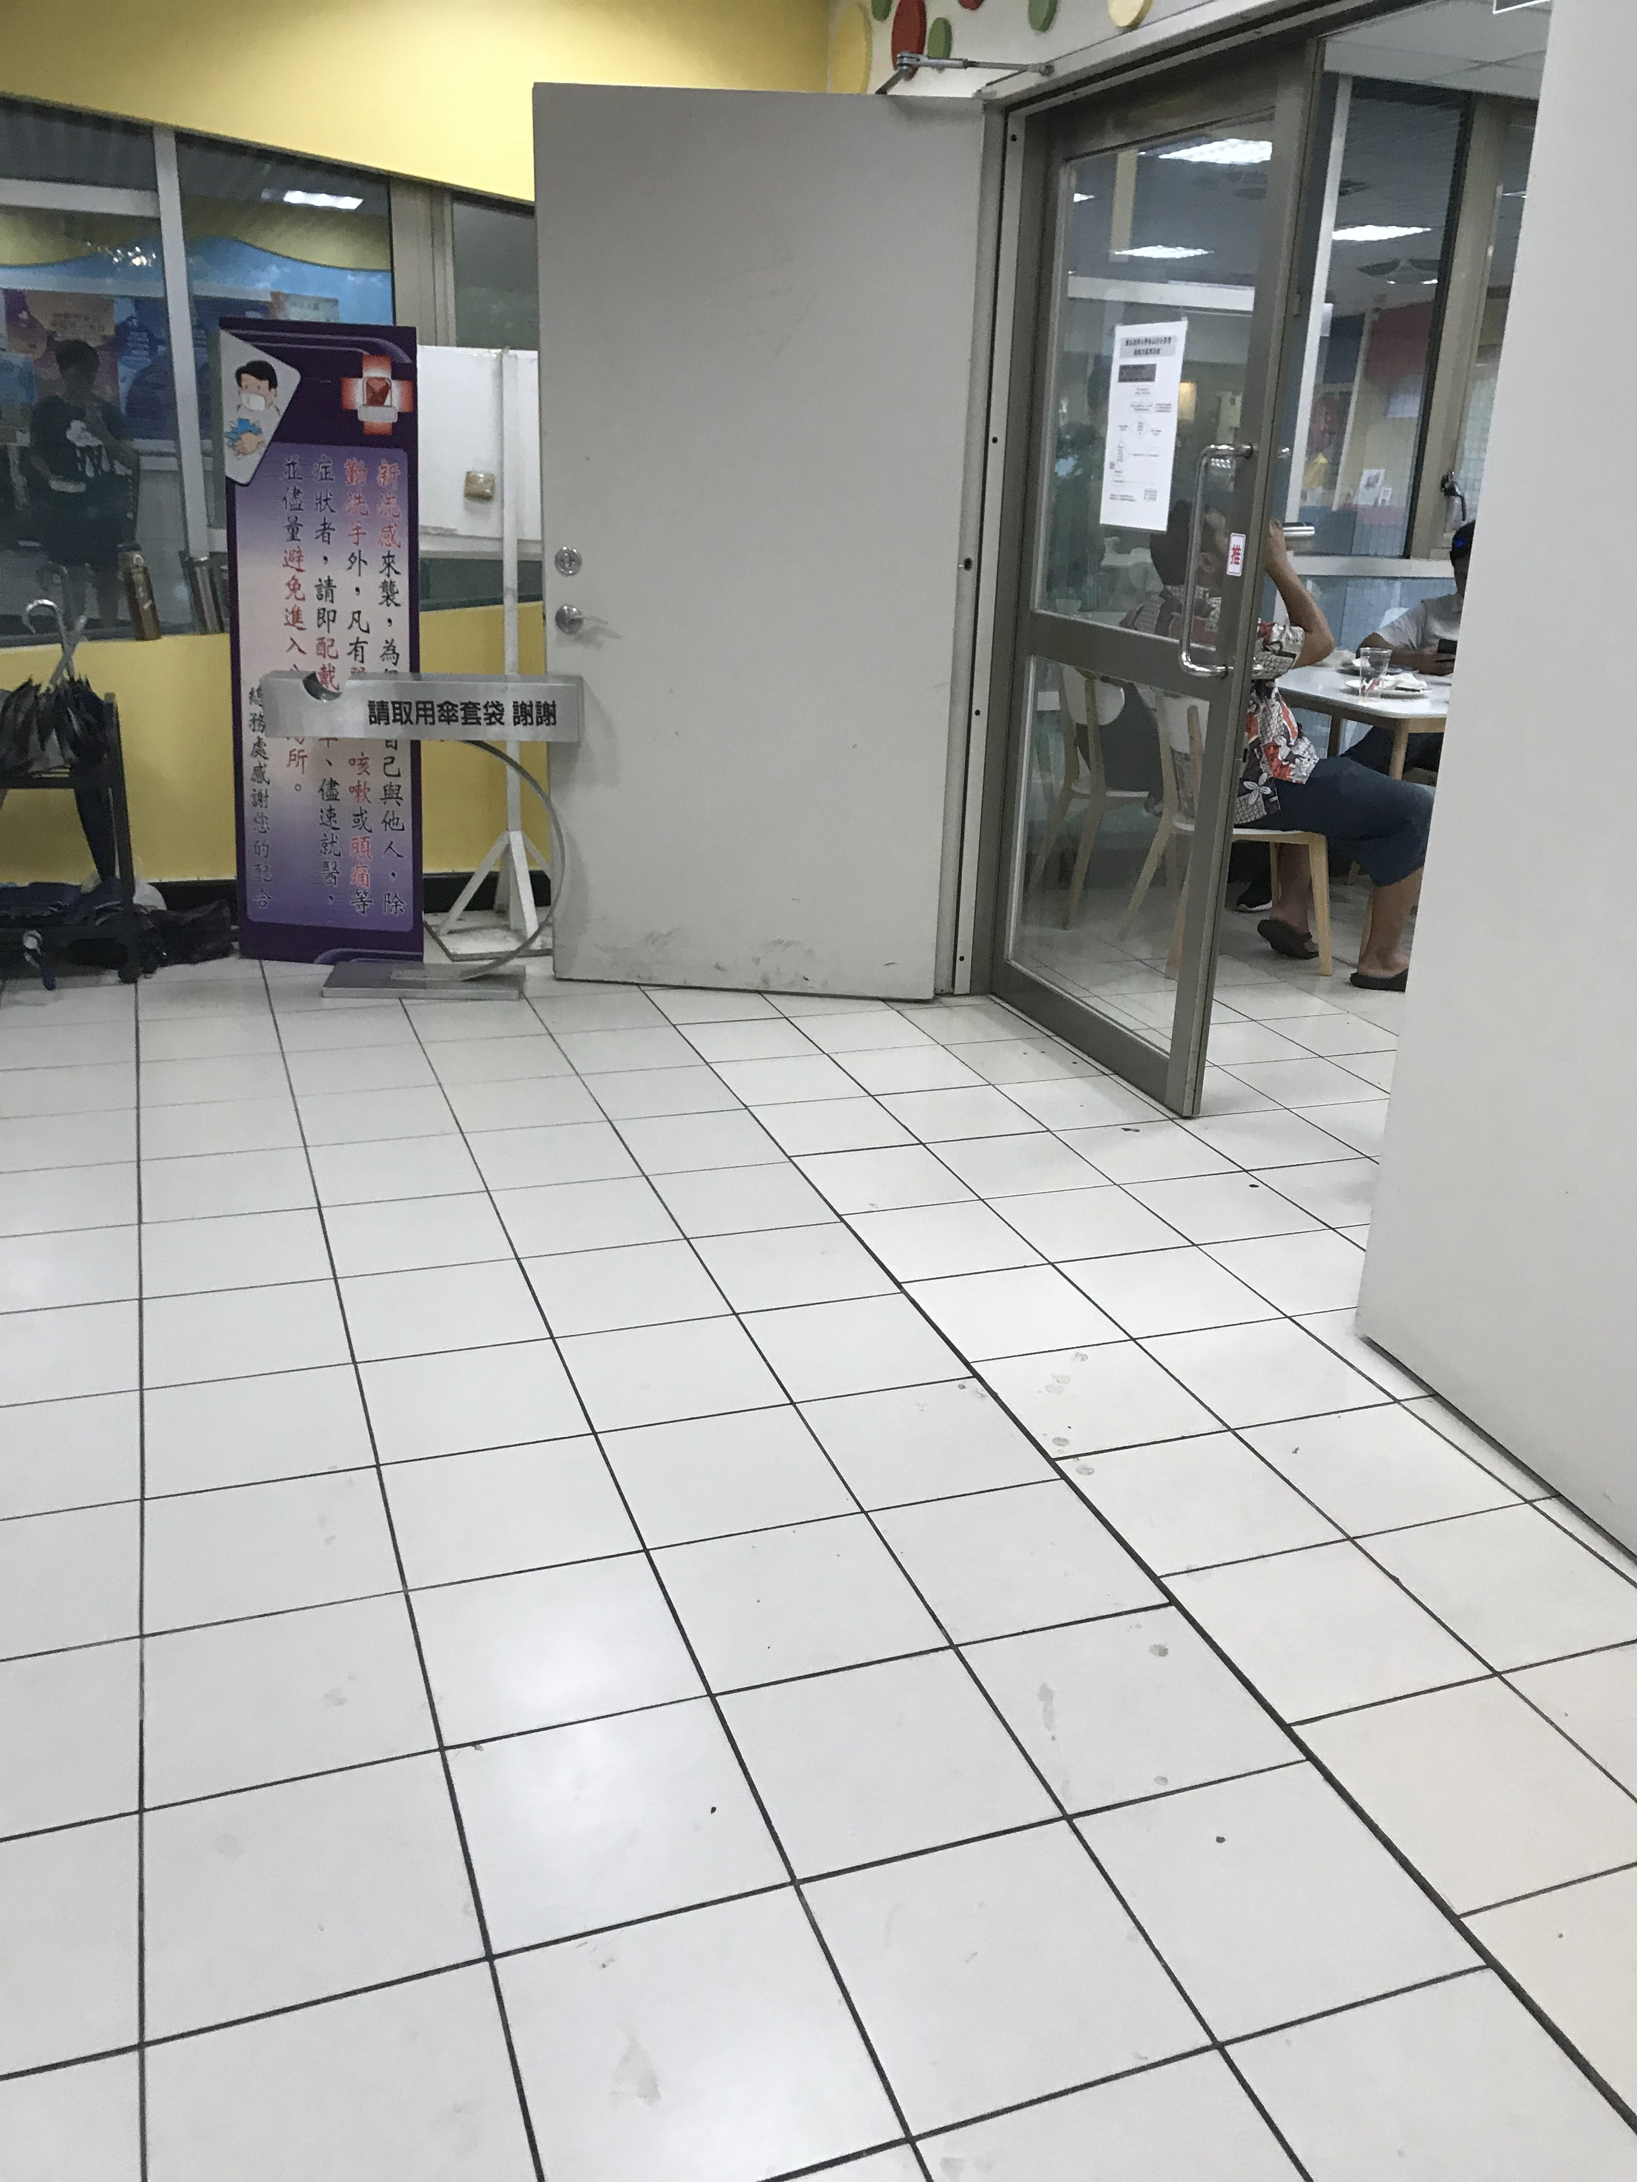
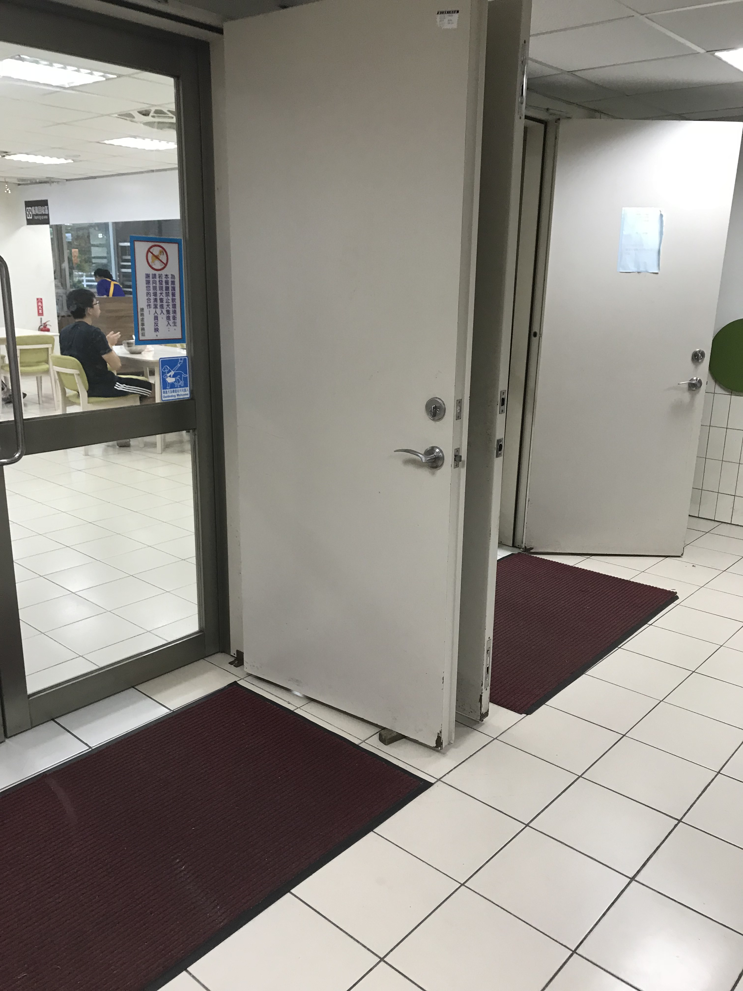
風雲2F
風雲3F

Slide 9
Probability reasoning process
1. Collect data
2. Find the expectation and variance
3. Calculate the PDF and CDF
4. Calculate the covariance and correlation coefficient
5. Use Chebyshev’s inequality to surmise the value in “whole university scale”
6. design the chart and summarize into a table

Slide 10
IDEA2
There are many basketball teams represents their department in NTHU
Problem:
Every player has their own jersey numbers,and each player in the same team has different jersey numbers!
Are there any relationship between numbers and the players?

Slide 11
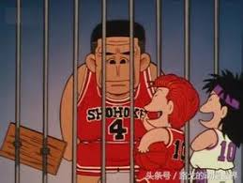
Goal of project
Find the relationship between players and their jersey numbers!(eq:Captain always wear number 4 ….)

Slide 12
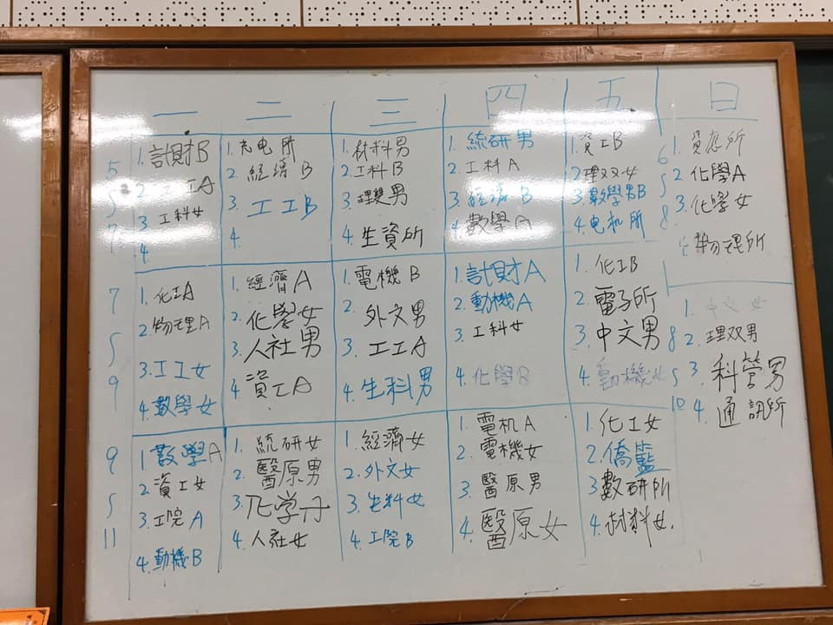
Method of collecting data
Each team’s training time is fixed.We can ask them during this schedule.

Slide 13
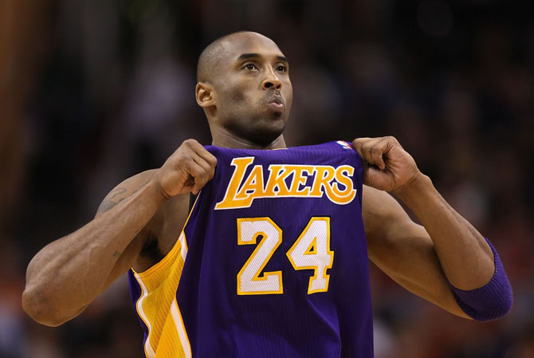
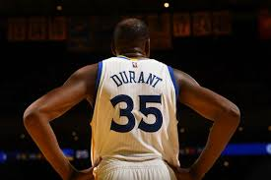
Principle of collecting the data
Ask each player on the team why they choose this jersey number and record their reason detailly.(Eq:their seat number,idols, birthday,girlfriend,or some special symbols,or they just choose a number ramdomly because senior students take the number they acuttually want)
Ask the captain’s number and the strongest player’s number

Slide 14
Probability reasoning process
1. Collect data
2. Find the relationship between number and reasons.
3. Find the probability of a specific reason with a particular number
4. design the chart and summarize into a table

Slide 15
Thanks for listening !!

